Slide 1

Laker Legacies
Kyle Peltier Matthew Williams Samantha Williams

Slide 2
Laker Legacies
Laker for a Lifetime!
Education
Philanthropy
Notes:
Laker Legacies App is meant to promote “Laker for a Lifetime” here at Grand Valley
It plans to accomplish this by informing people about buildings on all GV campuses and the history behind GVSU and its major contributors
Finally, GVSU hopes to encourage people to give back to the college

Slide 3
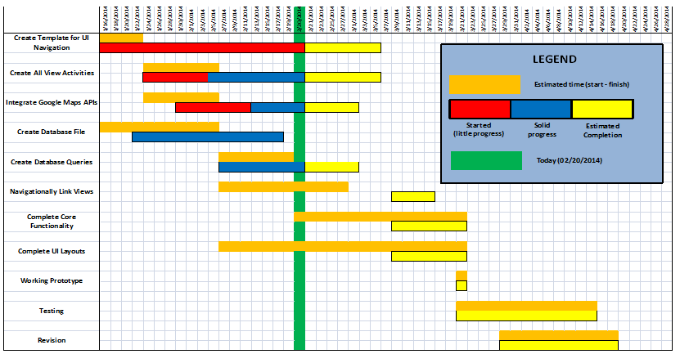
Gantt Chart
Notes:
Gantt chart shows the tasks we wished to complete by today which include: Template UI, All Activities, Google Maps APIs, Database, Queries. We hoped to also have started trying to link the UI of the application together by now.
As you can see, we’ve been set back quite a bit in development. The orage bars indicated the days in which we originally hoped to start and finish a task. The red block indicates time where we started working on the task but made little progress due to roadblocks. The blue bars indicate solid progress through the application. The yellow blocks indicate our future goals/estimates of completion of the tasks.

Slide 4
Intended Progress
UI templates
All Activities
Google Maps
Database and queries
Donate Page

Slide 5
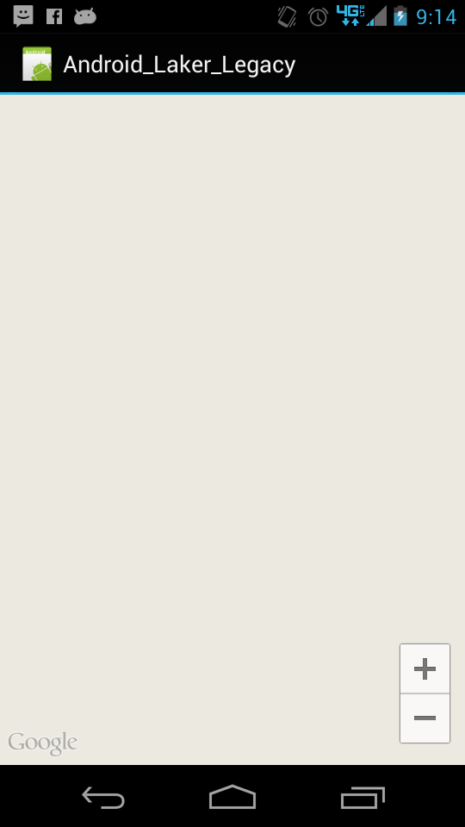
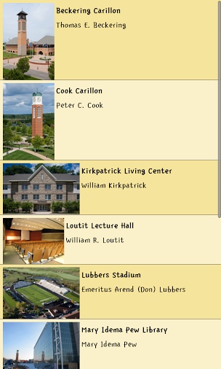
Actual Progress
Google Maps Blank Screen
Basic Directory of Buildings
Notes:
Google Maps:
Database:
We didn’t have all of the information for a database but we did have a subset of data. With this subset of data, we were able to parse data files and create the database programatically. This screenshot shows that we were able to create the database, do a basic query, and display the queried results to the screen. This is all done dynamically

Slide 6
Setbacks
API version compatibility with emulators and devices
Final design decisions not approved by customer
Google Service connection issues with Google Maps
Lack of data

Slide 7
Milestone 2
Emulators and devices working
XML layouts complete
Google Maps integrated
Donate page displayed
Most screens functional

Slide 8
Q&A

